Slide 1
MATHEMATICAL FOUNDATION FOR COMPUTER SCIENCE
Prepared by: Er. Ankit Kharel
Nepal college of information technology

Slide 2
Finite state automata
• Sequential Circuits and Finite state Machine
• Finite State Automata
• Non-deterministic Finite State Automata
• Language and Grammars
• Language and Automata
• Regular Expression

Slide 3
REGULAR EXPRESSIONS:
RG
(Regular Grammar)
A Language is regular if there is a regular grammar to generate it.
RL
(Regular Language)
FA
(Finite Automata)
A Language is regular if there is a exist a finite automata to accept it.
RE
(Regular Expression)
A Language is regular if there is a exist a regular expression to express it.

Slide 4
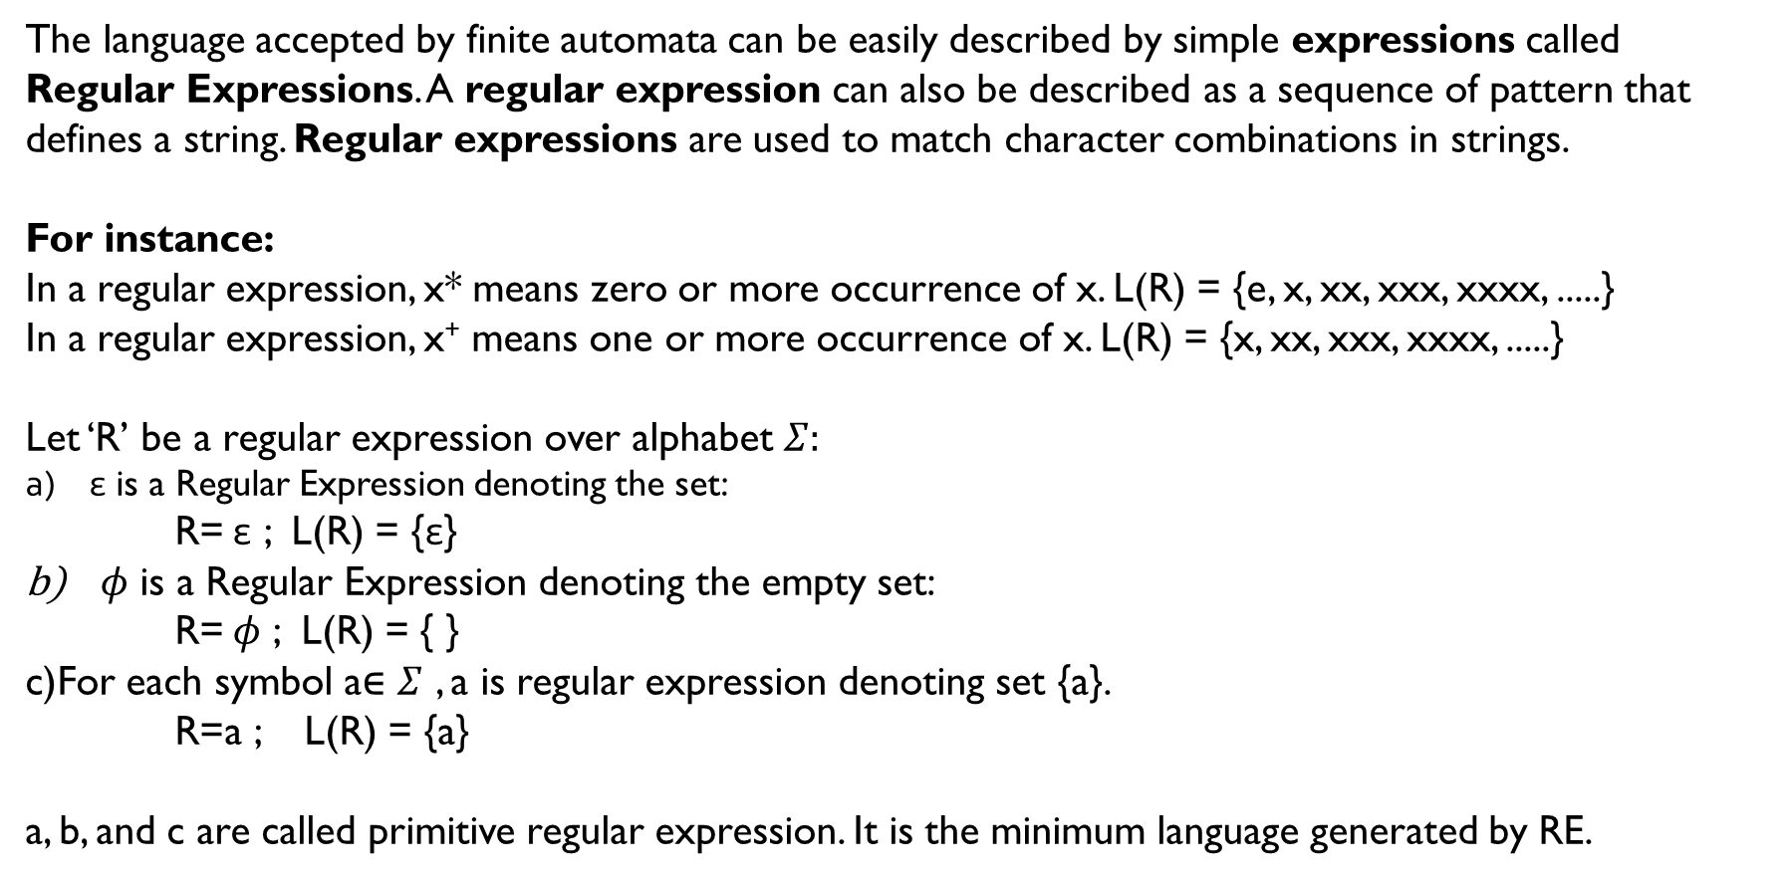
REGULAR EXPRESSIONS:
The language accepted by finite automata can be easily described by simple expressions called
Regular Expressions. A regular expression can also be described as a sequence of pattern that defines a string. Regular expressions are used to match character combinations in strings.
For instance:
In a regular expression, x* means zero or more occurrence of x. L(R) = {e, x, xx, xxx, xxxx, .....}
In a regular expression, x⁺ means one or more occurrence of x. L(R) = {x, xx, xxx, xxxx, .....}
Let ‘R’ be a regular expression over alphabet $Σ:$
ε is a Regular Expression denoting the set:
R= ε ; L(R) = {ε}
$φ$ is a Regular Expression denoting the empty set:
R= $φ$ ; L(R) = { }
c)For each symbol a∈ $Σ$ , a is regular expression denoting set {a}.
R=a ; L(R) = {a}
a, b, and c are called primitive regular expression. It is the minimum language generated by RE.

Slide 5
REGULAR EXPRESSIONS:
(Operators used in Regular expression)
d. Union(+) of two RE is also Regular;
R₁ = a , R₂ = b, R₁ U R₂ = a + b i.e. R₁ U R₂ = a + b generates language that contains either a or b
e. Concatenation(.) of two RE is also Regular;
R₁ = a , R₂ = b, R₁.R₂ = a.b i.e. R₁.R₂ = a.b generates language that contains a and b.
f. Kleene Closure of RE is also regular;
R₁ = a , R₁* = a*
g. Positive Closure of RE is also regular;
R₁ = a , R₁⁺ = a⁺

Slide 6
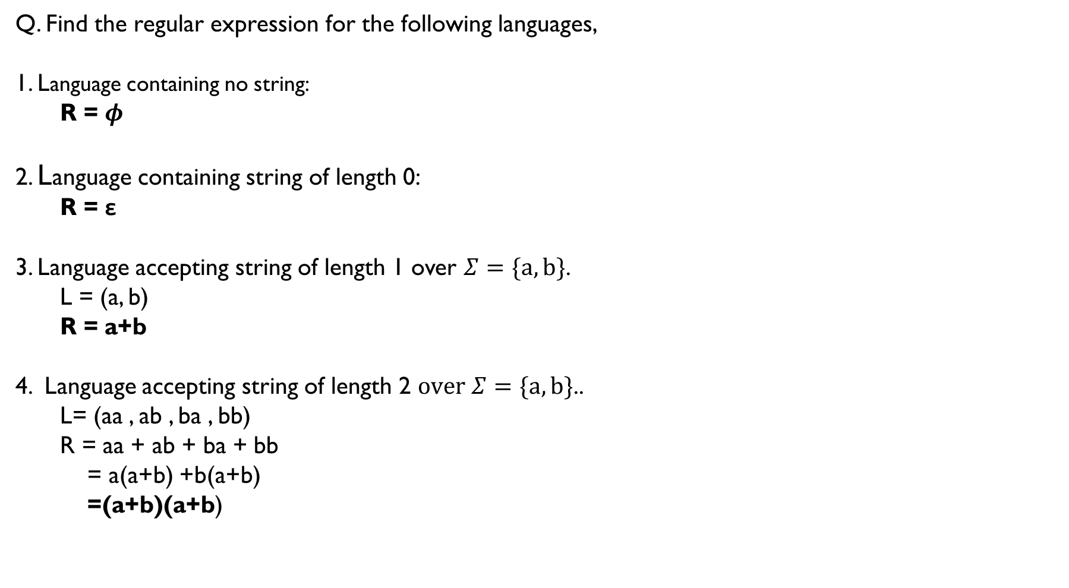
REGULAR EXPRESSIONS:
Q. Find the regular expression for the following languages,
1. Language containing no string:
R = $φ$
2. Language containing string of length 0:
R = ε
3. Language accepting string of length 1 over $Σ=\{a, b\}$.
L = (a, b)
R = a+b
4. Language accepting string of length 2 $over Σ=\{a, b\}$..
L= (aa , ab , ba , bb)
R = aa + ab + ba + bb
= a(a+b) +b(a+b)
=(a+b)(a+b)

Slide 7
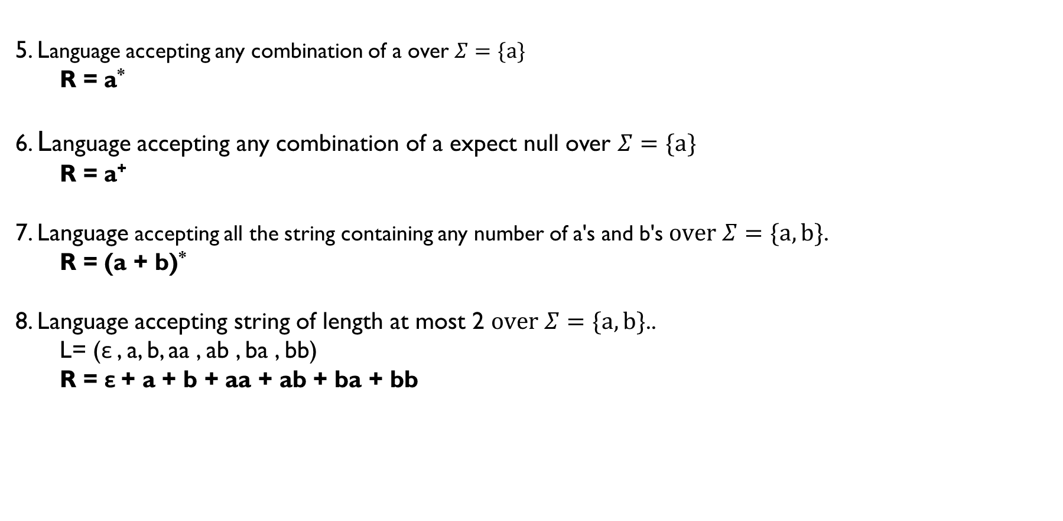
REGULAR EXPRESSIONS:
5. Language accepting any combination of a over $Σ=\{a\}$
R = a*
6. Language accepting any combination of a expect null over $Σ=\{a\}$
R = a⁺
7. Language accepting all the string containing any number of a's and b's $over Σ=\{a, b\}$.
R = (a + b)*
8. Language accepting string of length at most 2 $over Σ=\{a, b\}$..
L= (ε , a, b, aa , ab , ba , bb)
R = ε + a + b + aa + ab + ba + bb

Slide 8
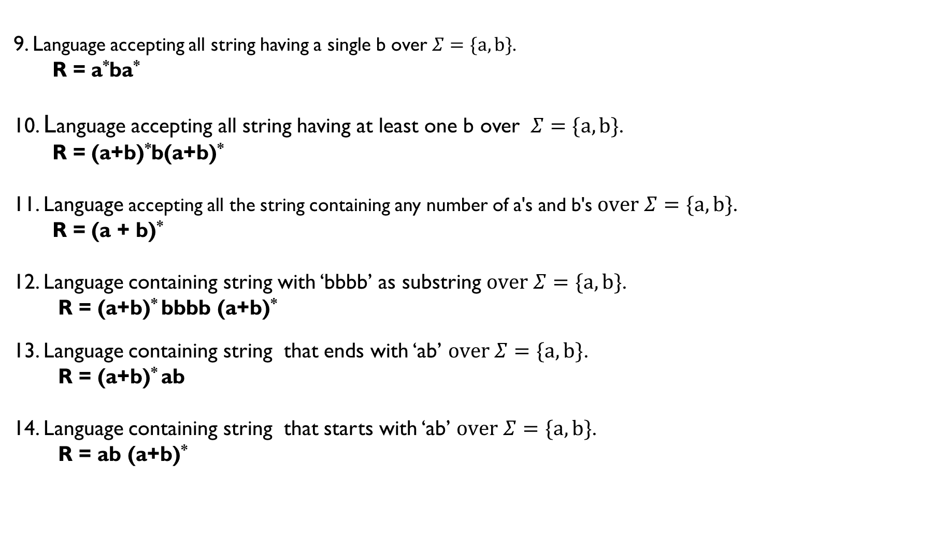
REGULAR EXPRESSIONS:
9. Language accepting all string having a single b over $Σ=\{a, b\}$.
R = a*ba*
10. Language accepting all string having at least one b over $Σ=\{a, b\}$.
R = (a+b)*b(a+b)*
11. Language accepting all the string containing any number of a's and b's $over Σ=\{a, b\}$.
R = (a + b)*
12. Language containing string with ‘bbbb’ as substring $over Σ=\{a, b\}$.
R = (a+b)* bbbb (a+b)*
13. Language containing string that ends with ‘ab’ $over Σ=\{a, b\}$.
R = (a+b)* ab
14. Language containing string that starts with ‘ab’ $over Σ=\{a, b\}$.
R = ab (a+b)*

Slide 9
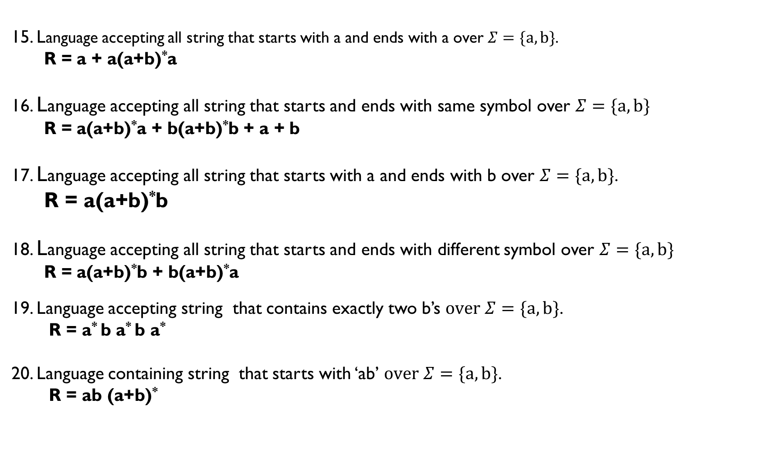
REGULAR EXPRESSIONS:
15. Language accepting all string that starts with a and ends with a over $Σ=\{a, b\}$.
R = a + a(a+b)*a
16. Language accepting all string that starts and ends with same symbol over $Σ=\{a, b\}$
R = a(a+b)*a + b(a+b)*b + a + b
17. Language accepting all string that starts with a and ends with b over $Σ=\{a, b\}$.
R = a(a+b)*b
18. Language accepting all string that starts and ends with different symbol over $Σ=\{a, b\}$
R = a(a+b)*b + b(a+b)*a
19. Language accepting string that contains exactly two b’s $over Σ=\{a, b\}$.
R = a* b a* b a*
20. Language containing string that starts with ‘ab’ $over Σ=\{a, b\}$.
R = ab (a+b)*

Slide 10
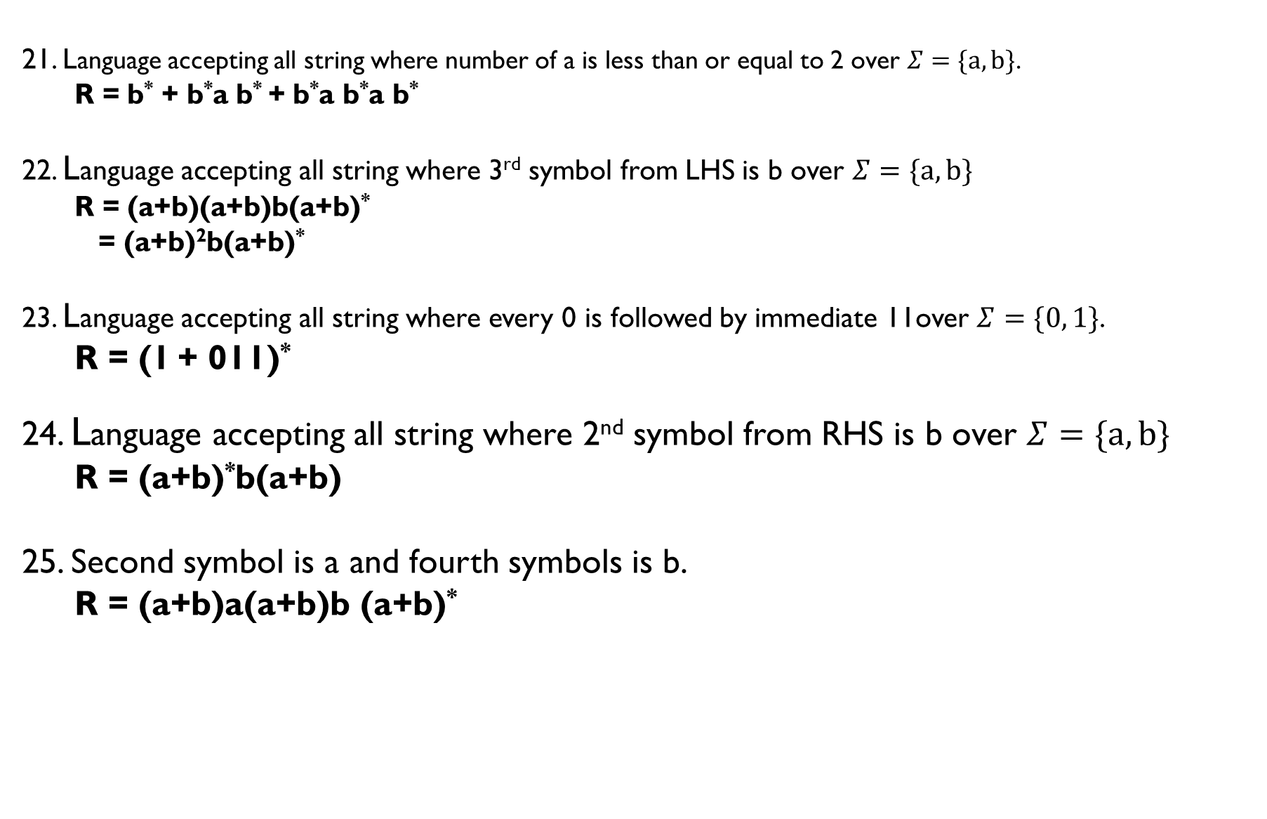
REGULAR EXPRESSIONS:
21. Language accepting all string where number of a is less than or equal to 2 over $Σ=\{a, b\}$.
R = b* + b*a b* + b*a b*a b*
22. Language accepting all string where 3rd symbol from LHS is b over $Σ=\{a, b\}$
R = (a+b)(a+b)b(a+b)*
= (a+b)²b(a+b)*
23. Language accepting all string where every 0 is followed by immediate 11over $Σ=\{0, 1\}$.
R = (1 + 011)*
24. Language accepting all string where 2nd symbol from RHS is b over $Σ=\{a, b\}$
R = (a+b)*b(a+b)
25. Second symbol is a and fourth symbols is b.
R = (a+b)a(a+b)b (a+b)*

Slide 11
Conversion of Finite automata to Re:
State Elimination Method:
= = = (a + b)*
= = = a.b
= = = (a+b)
= = = (ab)*
a, b
a+b
q₀
q₀
a
b
q₁
ab
q₃
q₁
q₂
q₃
a
q₁
q₂
q₁
a+b
q₃
b
a
ab
q₁
q₂
q₁
b

Slide 12
Conversion of Finite automata to Re:
4= = = a*.b
Steps to convert FA to RE:
1.If there exists any incoming edge to the initial state , create a new initial state having no incoming edge.
2. In case of multiple final states , convert them into non final state and create a new final state.
3.If there exist outgoing edge from final state create new final state having no outgoing edge.
4. Eliminate all intermediate state one by one . Only initial and Final state will be there. Their transition path will be our R.E.
b
q₁
a* b
q₃
q₁
q₂
a

Slide 13
Conversion of Finite automata to Re:
1. Convert Following to R.E
Solution:
i)Since there is no incoming edge in initial state, no outgoing edge from final state and there exist only one final state. So, start removing intermediate state .
ba*b
=
= a*ba*b(a+b)*
a
a
a , b
b
q₂
b
q₃
q₁
a
a , b
q₁
q₃
The Required R.E is:
a*ba*b(a+b)*
q₁
q₃

Slide 14
Conversion of Finite automata to Re:
2. Convert Following to R.E
Solution:
i)Since there is incoming edge in initial state, outgoing edge from final state
ii) Removing q₁
iii) Removing q₂
q₁
0
q₂
1
q₀
ε
q₁
0
q₂
ε
q₃
1
10
q₀
0
q₂
ε
q₃
The Required R.E is:
0.(10)*
q₀
0.(10)*
q₃

Slide 15
Conversion of Re to Finite automata :
Q.a (1+0)*10
1. Convert Following to Finite Automata
This is the required NFA
(1+0)*10
1
q₁
q₂
10
q₂
q₁
1, 0
1
q₂
0
q₃
q₁
1, 0

Slide 16
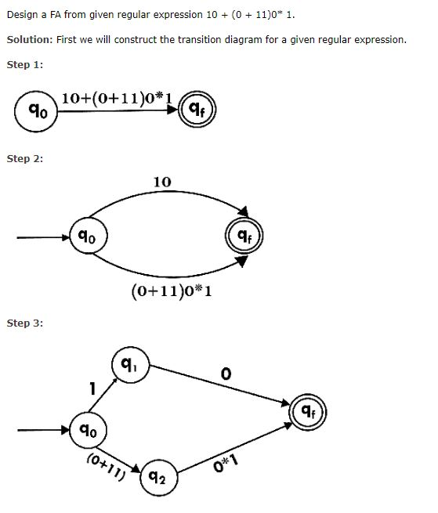
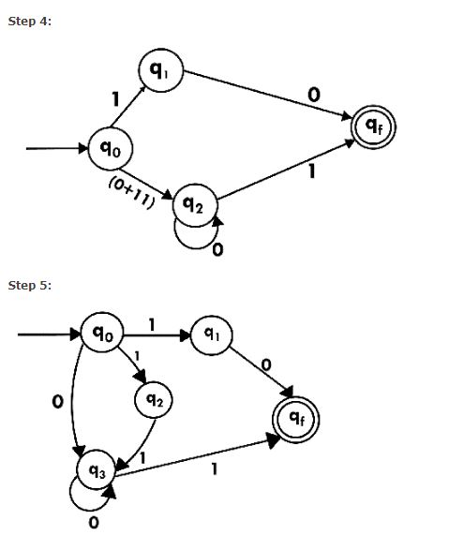
Conversion of Finite Re to automata :

Slide 17
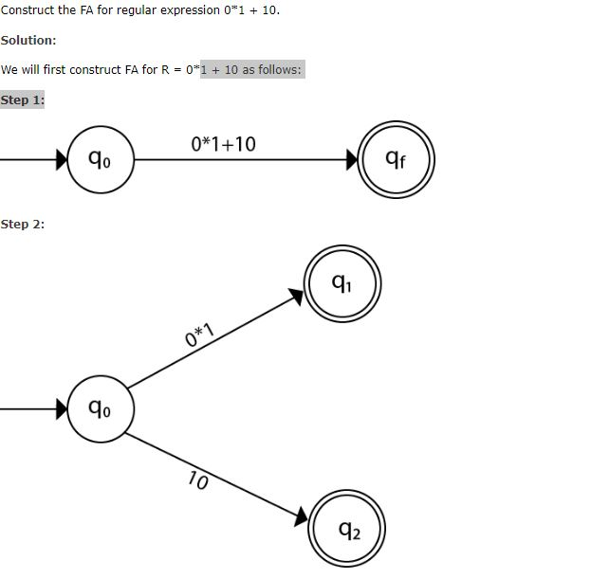
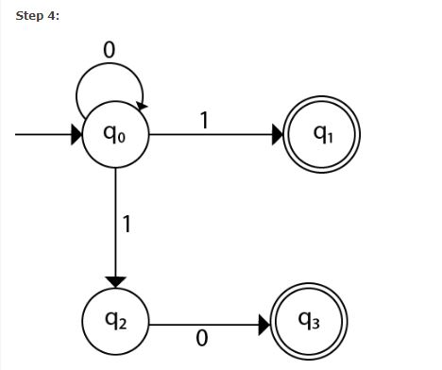
Conversion of Finite Re to automata :

Slide 18
